Slide 1
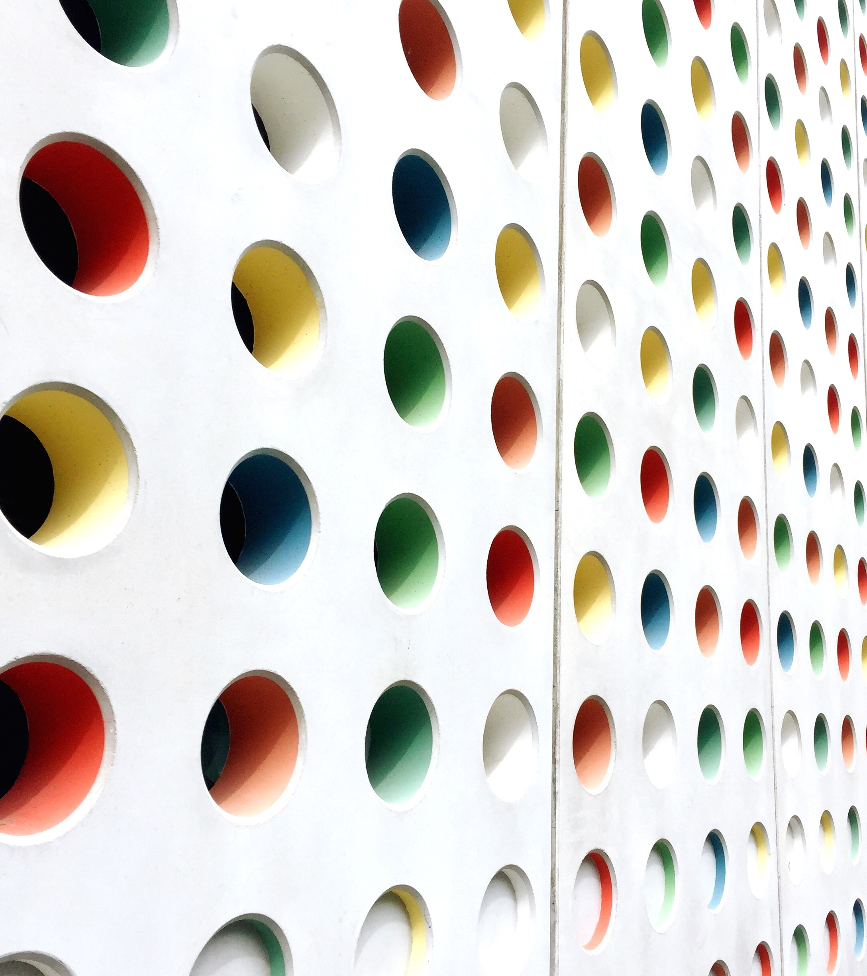
Data Structures Visualization Tool
Nishanth .t
Siddhartha reddy .d

Slide 2

Introduction
Our project aims to create a visualization tool for various data structures, along with a programming language to interact with them. We used Python, along with Turtle and Tkinter modules, to create a graphical representation of different data structures and their operations.

Slide 3
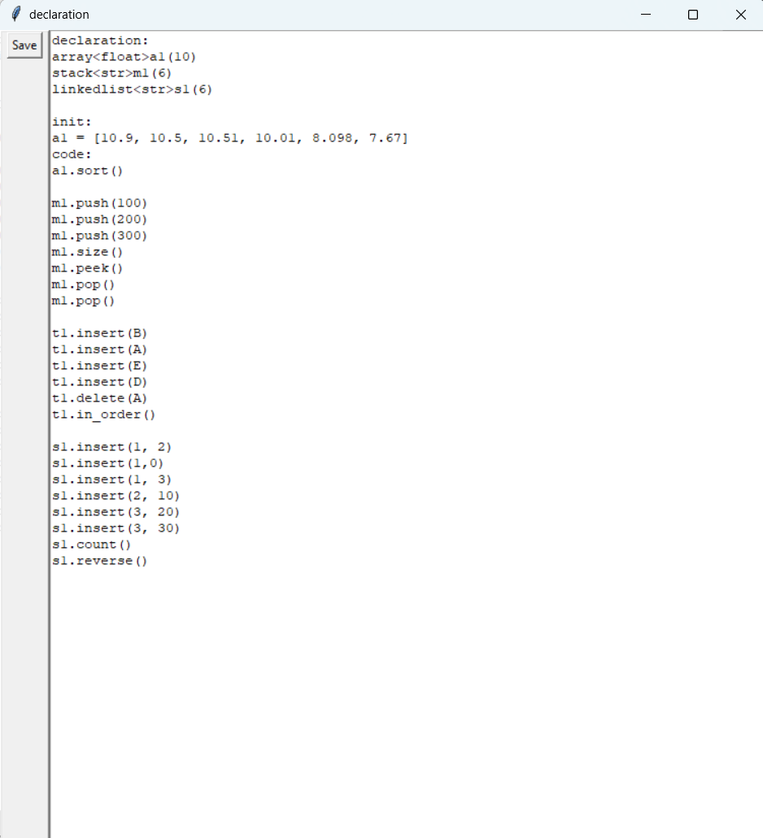
Programming data structures

Slide 4
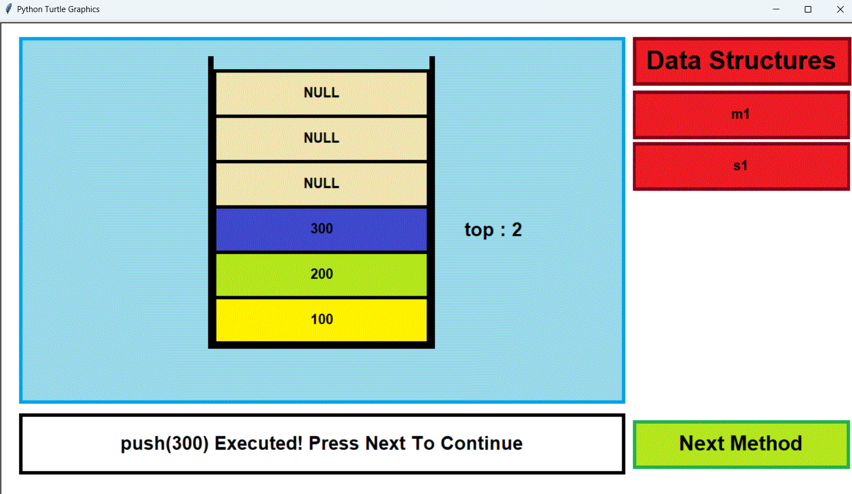
Visualization of data structures

Slide 5

Motivation
Data Structures are crucial in programming and are commonly tested in interviews. However, many students find them intimidating and struggle to understand how they work. Visualizing how data is manipulated can make it easier to comprehend and implement different data structures.

Slide 6
Main Features
The tool is an offline Python script that includes colorful image assets.
A simple programming language is included so that users can preview coding a data structure without worrying about programming syntax or semantics. The focus is on understanding how data is manipulated in each structure.
Text descriptions are provided for each operation performed, informing the user of progress.

Slide 7
Additional Features
The included programming language has an "init:" feature that allows users to initialize elements directly, rather than repeatedly inserting elements using multiple methods.
If the capacity of an object is not declared, the program automatically assigns the maximum capacity available for the data structure.
The program handles all exceptions, such as invalid method names, incorrect argument types, invalid size, simple syntax errors, and invalid object initializations.

Slide 8
Future Developments
To optimize usage, we plan to create a web application.
This web app will utilize dynamic environments and web architecture to provide a more user-friendly interface for editing code and visualizing data structures.
We aim to increase the maximum capacity of every data structure and improve exception handling mechanisms to further improve the tool's user-friendliness.

Slide 9

THANK YOU

